Slide 1

TROD
Akciğer Kanseri’nde
Kanıta Dayalı Güncel Yaklaşım Toplantısı
KHAK’inde PKI
Dr.Evrim Tezcanlı
Notes:
As an excellent tool to study the pathogenesis of human diseases and explore the principles of disease prevention and treatment, animal models are constantly providing new ideas for cancer research. However, there are some differences in physiology, heredity and immunity between animal models and human beings. Therefore, it is an urgent need for the current biomedical development to develop animal models that can better reflect human biological characteristics and replace human beings to carry out preclinical research. –LI
Animal models refers to the animal experimental objects and related materials that can simulate human body established in medical research. As the second-largest disease in terms of morbidity and mortality after cardiovascular disease, cancer has always been the focus of human attention all over the world, which makes it a research hotspot in the medical field. At the same time, more and more animal models have been constructed and used in cancer research. With the deepening of research, the construction methods of cancer animal models are becoming more and more diverse, including chemical induction, xenotransplantation, gene programming, and so on. In recent years, patient-derived xenotransplantation (PDX) model has become a research hotspot because it can retain the microenvironment of the primary tumor and the basic characteristics of cells. Animal models can be used not only to study the biochemical and physiological processes of the occurrence and development of cancer in objects but also for the screening of cancer drugs and the exploration of gene therapy. In this paper, several main tumor animal models and the application progress of animal models in tumor research are systematically reviewed. Finally, combined with the latest progress and development trend in this field, the future research of tumor animal model was prospected. -lı
Decades of focused cancer research has revealed that tumorigenesis is a frustratingly complex process, with scientists still grappling with an incomplete understanding of the disease’s genetic basis. Surprisingly, animal models are used heavily in human cancer genetics. Selection of the best cancer model is always challenge to the scientists because there is no unique system which relies on basic features like genome stability, heterogeneity of transplanted cell lines, immunogenicity within the host and accuracy in biological endpoints. As a result, there is no better model that explains the complexities of cancer disease; therefore, research is ongoing to develop a better model that provides an insightful resource for understanding the cellular and molecular processes in order to improve prognosis.-ADUSUMALLI

Slide 2
Konular
Sınırlı Evre Hastalıkta PKI için kanıt
Yaygın Evre Hastalıkta PKI için kanıt
PKI toksisitesini azaltmak için Hippokampal Koruma
Gelecekte bizi neler bekliyor?
Sonuç

Slide 3
PKI
Sınırlı Evre

Slide 4
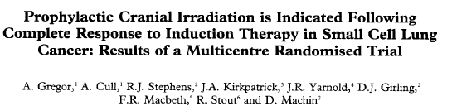
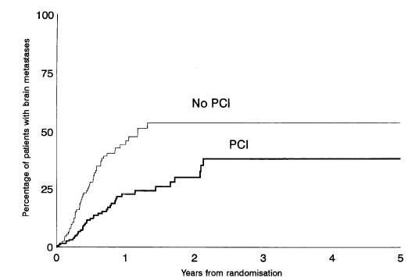
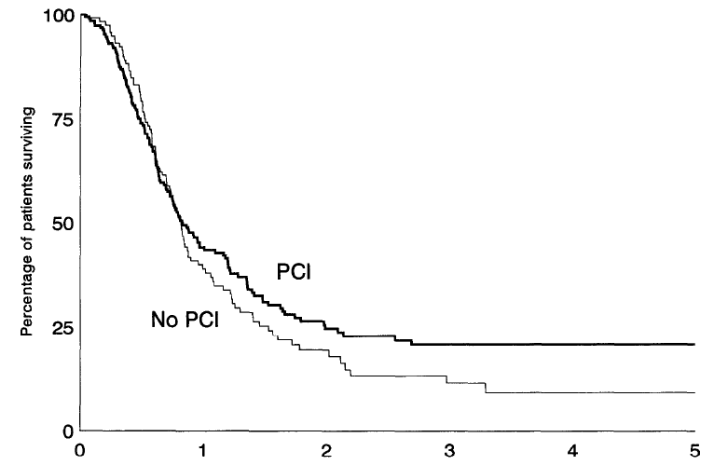
UKCCCR / EORTC
Tam yanıtlı 314 olgu
% 100 Sınırlı evre
36/18 vs 24/12 vs no PKI
Sonrasında PKI vs no PKI
Her iki grupta da PKI öncesi NK ↓
3 y BM
% 38 vs % 54 (HR: 0.44 p<0.00004)
3 y GS
% 21 vs % 11 (HR: 0.44 p<0.25)
PKI tam yanıtlı olgularda BM gelişim riskini ↓, GS etki Ø, NKF’e etki Ø
European Journal of Cancer Vol. 33, No. 11, pp. 1752-1758, 1997
Notes:
This trial has confirmed that PCI, given at the end of induction therapy, substantially reduced the likelihood of cranial relapse of small cell lung cancer. This finding supports the previously reported trials [4, 19, 201. The estimated risk was reduced from 54% to 30% at 2 years after randomisation and from 54% to 38% at 3 years, a substantial gain in a situation with devastating consequences for patients.
BM: There was a large and highly significant difference in favour of the PC1 group (HR = 0.44, 95% CI 0.29-0.67, P = 0.00004). The percentages were 30% in the PC1 group and 54% in the No PC1 group at 2 years and 38% and 54% at 3 years
GS: The survival comparison by treatment group is shown in Figure 3. The advantage to PC1 is not statistically significant (HR= 0.86, 95% CI 0.66-1.12, P= 0.25). Median survival was 305 days in the PC1 group and 300 in the No PC1 group; the estimated survival rates were 44% and 39% at 1 year, 25% and 19% at 2 years and 21% and 11% at 3 years, respectively.

Slide 5
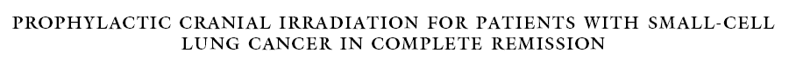
7 RKT- MR öncesi çalışmalar, sonlanım noktası Sağkalım
Tam yanıtlı 987 olgu
% 85 sınırlı, %15 yaygın evre
3 yıllık SK oranında %5,4’lük mutlak ↑ (%20,7 vs %15,3; p=0,01)
HSK’da % 8,8’lik mutlak ↑ (p<0,001)
Beyin metastazlarının kümülatif insidansında ↓ (p<0,001)
Yüksek doz PKI ile beyin metastazı riskinde bir miktar ↓ (p=0,02), ancak SK’a etkisi yok (8 Gy, 24-25 Gy, 30 Gy ve 36-40 Gy)
Zamanlama: Sadece 1 çalışma prospektif bakmış, fark saptanmamış. Ancak, metaanalizde PKI erken yapılırsa (indüksiyon KT nin başlamasından sonra) beyin metastazı riskinde azalma eğilimi +
Auperin A, et al. N Engl J Med 1999; 341:476-484.
Notes:
3 yıllık SK oranında %5,4’lük mutlak (%20,7 vs %15,3; p=0,01)
HSK’da %8,8’lik mutlak (p<0,001)
Beyin metastazlarının kümülatif insidensinde (p<0,001)
Yüksek doz PKI ile beyin metastazı riskinde daha fazla (p=0,02), ancak SK’a etkisi yok
PKI erken yapılırsa (indüksiyon KT’sinin başlamasından sonra) beyin metastazı riskinde azalma eğilimi

Slide 6

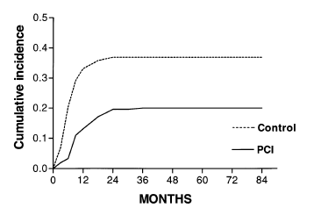
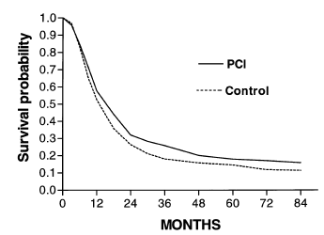
Fransız çalışması
2 randomize çalışma, tam yanıtlı 505 olgu
≈ % 82 sınırlı evre
5y İzole ilk yineleme bölgesi olarak BM
% 37 vs % 20 (p<0.001)
5 y BM oranı
RR: 0.50 % 59 vs % 43 (p<0.001)
5 y GS
% 15 vs % 18 (RR: 0.84 p<0.06)
Sonuç: PKI tam yanıtlı olgularda BM gelişim riskini ↓, GS ≈
Arriagada R, et al. Annals of Oncology 13: 748–754, 2002
Notes:
Fransız çalışması
2 randomize çalışma, tam yanıt alınmış 505 olgu
≈ % 82 sınırlı evre
Five hundred and five patients were analyzed.
Şekil 1. The 5-year cumulative rate of brain metastasis as an isolated first site of relapse was 37% in the control group and 20% in the PCI group (P <0.001).
The overall 5-year rates of brain metastasis were 59% and 43%, respectively [relative risk (RR) 0.50;P <0.001].
The 5-year overall survival rates were 15% in the control group and 18% in the PCI group(RR 0.84; P = 0.06).
PCI given to patients with SCLC in complete remission significantly decreased the risk of developing brain metastases. This effect was the same whether total brain metastasis or brain metastasis as the first site of failure was used in the assessment. Other events were not influenced by treatment. The effect of treatment on overall survival was not significant, but the relative death risk reduction (0.84) was similar to that observed in the meta-analysis [15], but of borderline significance (P = 0.06).

Slide 7
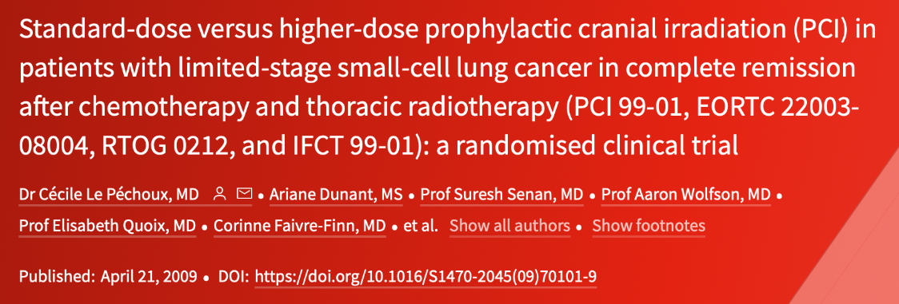
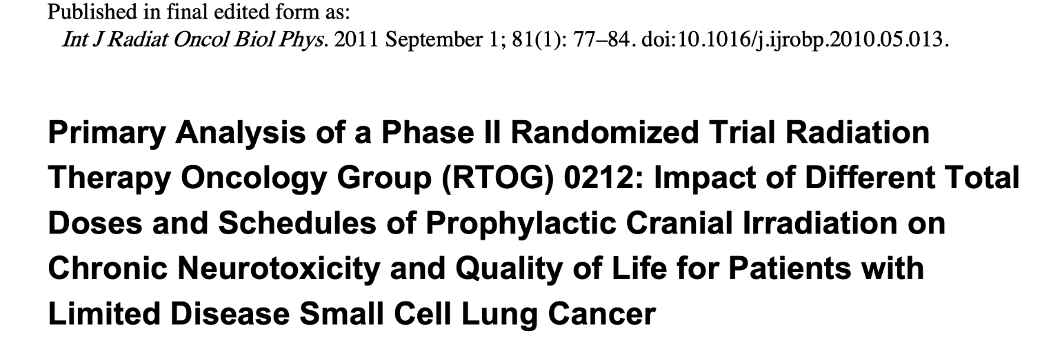
RTOG 0212/EORTC 22003: standart 25Gy/10fr vs yüksek doz 36Gy/12fr
Standart doz ile daha iyi sağkalım %42 vs %37 (p 0.05)
2 y beyin mets insidansında fark yok %29 vs %23
BM insidansında Δ Ø
Yüksek dozda mortalitede ve yan etkilerde (halsizlik, bulantı, baş ağrısı) ↑ (+)
25 Gy standart kalmalı

Slide 8
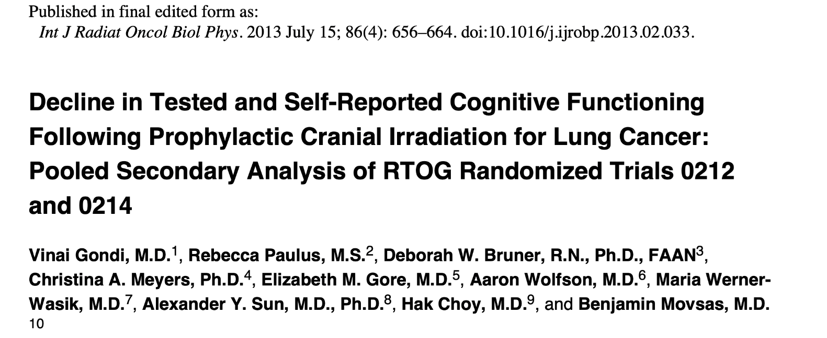
-RTOG 0214: KHDAK PKI 30Gy/15fr vs no PKI
-RTOG 0212 ve 0214 birleştirilmiş analizi
-410 PKI vs 173 PKI almayan hasta
-PKI ile 6. ve 12. ayda HVLT (p<0.0001) ve hasta tarafından bildirilen kognitif anlamlı kötüleşme (p=0.002)
- PKI ile 3 kat artmış NK bozulma riski

Slide 9
Özet
Hiçbir RCT tek başına sağkalım avantajı göstermemiş.
Sadece Auperin meta-analizinde %5 lik mutlak fayda var
Çeşitli dozlar kullanılmış: Auperin
Yüksek doz ile sağkalım daha kötü: RTOG 0212/EORTC 22003
NK fonksiyonlar etkileniyor: RTOG 0212+ RTOG 0214 analizi
IT ile beraber PKI?

Slide 10
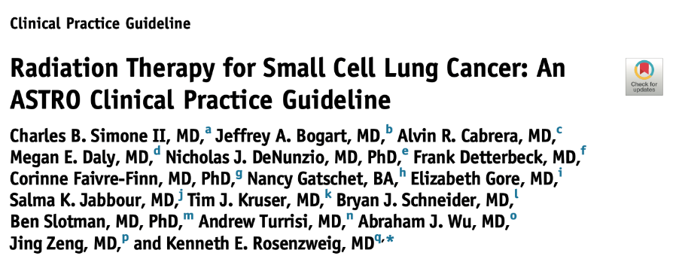
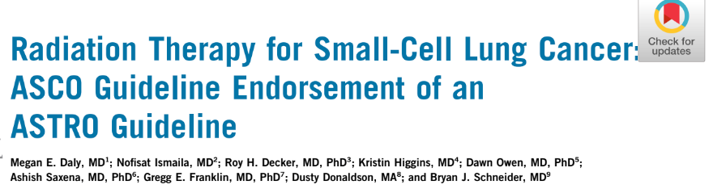

Slide 11
ASTRO-ASCO
Soru: SE-KHAK’nde PKI
Kanıt düzeyi | Öneri düzeyi
Düşük | Güçlü
Düşük | Zayıf
Yüksek | Güçlü
Düşük | Güçlü
Orta | Güçlü
KT’ye yanıt (+) → PKI öncesi k-MRG re-evreleme önerilir
Evre I’de genel olarak PKI önerilmez
Evre II/III,<70y,ECOG 0-2, KT’ye yanıt (+) PKI önerilir
Yaşlı, sınırlı performans ve/veya ko-morbidite → ortak karar
PKI dozu 25 Gy/10fr önerilir
Simone ve ark. Int J Radiat Oncol Biol Physcs 2020
Daly ve ark JCO 2021
Notes:
The ASCO Expert Panel agrees with ASTRO recommendation for shared decision making around PCI for ES-SCLC, given an alternative to PCI exists in MRI surveillance,15 and this approach has been shown to be effective in a randomized trial. However, PCI should remain the standard of care in LS-SCLC, until further data are available that show MRI surveillance in lieu of PCI does not compromise overall survival (OS), given that cure is possible in limited-stage disease. The panel agrees that there are individual cases of LS-SCLC where the risks of neurocognitive toxicity may outweigh the potential benefit to PCI, particularly in patients with marginal performance status or baseline neurologic deficits. These cases should be considered on a case-bycase basis, with shared decision making employed.-DALY
PCI in early-stage disease is controversial and has been
particularly questioned in surgical patients with N0 disease.-BOGART
5-year brain metastasis risk was relatively low (12%, 95% CI: 8%-17%) for p-stage I patients without PCI. YANG-MTA

Slide 12
PKI
Yaygın Evre
Notes:
the use of PCI may further decrease if IO can reduce the incidence of brain metastasis in ESSCLC patients –HAN 7 REF
The use of PCI in patients with ES-SCLC is controversial. The EORTC study[38] showed that PCI reduced the incidence of BM from 40% to 15%, prolonged median survival (from 5.4 mo to 6.7 mo) and improved OS rates (27% to 13%). However, prior to initiation of PCI, no imaging test was required in that study. In the study conducted by Takahashi et al[122] all patients underwent MRI prior to PCI. The cumulative incidence of BM in the two arms (PCI vs observation) was 48% and 69%, respectively. Despite the lower rate of BM with PCI, this did not improve OS (Table 6).
The PCI dose in ES-SCLC is 2500 cGy in 10 frations (level of evidence I, grade of recommendation A) and 2000 cGy in 5 fractions[38]; however, the neurocognitive effects of the latter scheme have not been fully investigated. Although two MTA and one pooled analysis have shown that PCI improves OS in
patients with ES-SCLC[157-149], the result of another MTA called into question the value of PCI[150]. Consequently, the decision to use PCI or not should be discussed with the radiation oncologist. Patients with ES-SCLC who progress after PCh should not receive PCI-Caunago

Slide 13
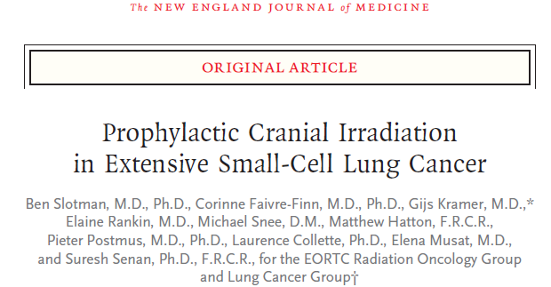
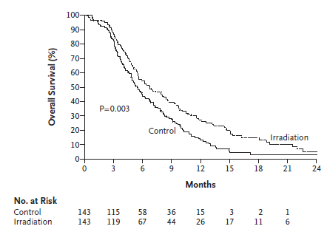
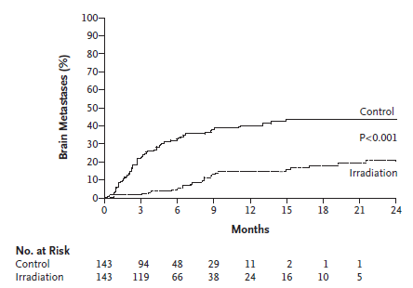
n= 286
Kurtarma RT %59
25Gy/10fr, 20Gy/5fr (%60), 30Gy/10- 12-15fr
1y GS %27 vs %13
Med GS 6.7 vs 5.4 mo
Semptomatik BM
1 y %15 vs %40
Semptom yoksa beyin görüntülemesi Ø
Sonuç: PKI semptomatik BM insidansını ↓, PFS ve GS↑
Notes:
EORTC çalışması RCT ANY RESPONSE TO CT No baseline brain imaging (Beyin metastazı randomizasyon öncesi dışlanmamış)Bazı vakalarda platinsiz indüksiyon KT, Tanıda subklinik beyin mets?, Farklı PCI şemaları?
(20 Gy/5-8 fr, 24 Gy/12 fr 25 Gy/10 fr, 30 Gy/10-12 fr, Beyin metastazı için tanıda evrelemede BT +/- MRG
BU ÇALIŞMADAN SONRA STANDART KOL OLMUŞ.
6hf ve 3 ay HRQoL (yorgunluk ve saç dökülmesi kontrole göre PCI da daha yüksek-PUTORA
Beyin görüntüleme tanı ve izlemde standart değil Doz/fr standart değil 1 y GS %14 artmış (2 KATINA ÇIKMIŞ). The study reported higher rates of hair loss and fatigue with PCI, although there were no statistically significant differences in cognitive functioning or emotional functioning. The authors concluded “prophylactic cranial irradiation should be part of standard care for all patients with small-cell lung cancer who have a response to initial chemotherapy, and it should be part of the standard treatment in future studies involving these patients”. Before long, PCI become the standard of care for ES-SCLC in multiple evidence-based clinical practice guidelines (Table TAYLOR
BRAİN İMAGİNG WAS NOT MANDATORY5X4GY
Primer sonlanım: The primary outcome was time to symptomatic brain metastases (no MRG iile izlem yok sadece sx olursa imaging yapılmış, kontrol kolunda daha fazla met gelişmiş, genel durumu bozmuş ve ek tedavi almasını engellemiş olabilir.)while OS, toxicity and treatment costs were secondary outcomes. TAYLOR
lower risk of symptomatic brain metastases (hazard ratio, 0.27; 95% confidence interval [CI], 0.16 to 0.44; P<0.001). The cumulative risk of brain metastases within 1 year was 14.6% in the irradiation group (95% CI, 8.3 to 20.9) and 40.4% in the control group (95% CI, 32.1 to 48.6).
Irradiation was associated with an increase in median disease-free survival from 12.0 weeks to 14.7 weeks and in median overall survival from 5.4 months to 6.7 months after randomization. The 1-year survival rate was 27.1% (95% CI, 19.4 to 35.5) in the irradiation group and 13.3% (95% CI, 8.1 to 19.9) in the control group-NCCN
The use of PCI in patients with ES-SCLC is controversial. The EORTC study[38] showed that PCI reduced the incidence of BM from 40% to 15%, prolonged median survival (from 5.4 mo to 6.7 mo) and improved OS rates (27% to 13%). However, prio to initiation of PCI, no imaging test was required in that study-CAUNAGO
Conversely, among patients in the surveillance arm of the EORTC trial who developed symptomatic brain metastases, only 59% received salvage radiation. Thus, 41% with symptomatic brain metastases in the observation arm of the EORTC trial were unable to receive salvage radiation, raising the question of whether this difference could have contributed to the decreased OS without PCI. TAYLOR
This is an important limitation of this study. If mandatory screening MRI had been performed, the benefit of PCI may have been less than what was reported. If more frequent surveillance MRI of the brain had been performed, one could postulate that intracranial progression could have been detected earlier, potentially leading to higher rates (and efficacy) of salvage brain-directed RT. -NESBIT

Slide 14
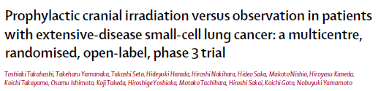
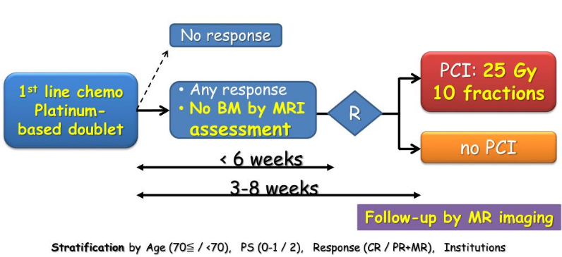
Notes:
Buna karşın
330 any response
Tanı anı mRG’de metastazı olmayan olgularda PCI, MRG ile yakın izlem ve asemptomatik beyin metlerin erken tanınmasıyla yapılan salvaj RT koluna göre sağkalımı arttırmamıştır.
Follow up MRG: ilk yıl 3 ayda bir sonra 6 ay
PLANLANMIŞ AMA İNTERİM ANALİZDE FAYDASIZLIK ÖRÜLÜNCE SONLANDIRILMI-NOSAKİIn the study conducted by Takahashi et al[122] all patients underwent MRI prior to PCI. The cumulative incidence of BM in the two arms (PCI vs observation) was 48% and 69%, respectively.Despite the lower rate of BM with PCI, this did not improve OS (Table 6).The PCI dose in ES-SCLC is 2500 cGy in 10 fractions (level of evidence I, grade of recommendation A) and 2000 cGy in 5 fractions[38]; however, the neurocognitive effects of the latter scheme have not been fully investigated-CAUNAGO
Conversely, among patients in the surveillance arm of the EORTC trial who developed symptomatic brain metastases, only 59% received salvage radiation. Thus, 41% with symptomatic brain metastases in the observation arm of the EORTC trial were unable to receive salvage radiation, raising the question of whether this difference could have contributed to the decreased OS without PCI.TAYLOR
Other potential explanations for the differences in the effect of PCI may include biologic heterogeneity between the European and Japanese populations that has impacted randomized trial data before TAYLOR
PCI deteriorates survival compared with a periodic follow-up with brain MRI, and the negative impact on quality-of-life due to prolonged anorexia and nausea after PCI was considered to be a primary reason OUTCHI
Although two MTA and one pooled analysis have shown that PCI improves OS in patients with ES-SCLC[157-149], the result of another MTA called into question the value of PCI[150]. Consequently, the decision to use PCI or not should be discussed with the radiation oncologist. Patients with ES-SCLC who progress after PCh should not receive PCI-Caunago
In ES-SCLC, the use of PCI was examined in a randomized trial of patients with any response to upfront chemotherapy.10 Patients had no known BMs, but brain imaging was not mandated as part of the standard staging or follow-up procedures. PCI reduced symptomatic BMs and resulted in improved OS. Similarly, meta-analyses8,81,94,95 and some pooled analyses82,83 demonstrated OS to be favorably associated with PCI usage in ESSCLC.
However, a different meta-analysis questioned the OS benefit of PCI in ES-SCLC.96 A more contemporary Japanese randomized study was designed to
examine MRI surveillance compared with PCI.13 PCI resulted in a significantly decreased burden of BMs compared with MRI surveillance (48% vs 69%). However, OS was not improved.13 It should be noted that no quality of life and limited neurocognition data are available from this trial. Therefore, for patients who can adhere to the schedule, MRI surveillance can be considered an alternative to PCI. The task force recommends consultation with a radiation oncologist regarding the benefits and risks of PCI versus MRI surveillance. Similar to patients with LS-SCLC, patients with ES-SCLC who progress
after initial therapy should not be recommended for PCI. Among patients with ES-SCLC who elect to have PCI, the task force agreed that data supporting utilization of 2500 cGy in 10 fractions are likely applicable regarding disease control and neurotoxicity.92,93 This regimen has
been extensively used in patients with ES-SCLC undergoing PCI.10,97,98 However, given that the strongest randomized data supporting PCI for ES-SCLC delivered 2000 cGy in 5 fractions of 400 cGy to 62% of the patients receiving PCI,10 that fractionation scheme also garnered support as an evidence-based regimen, although neurocognitive effects for this scheme have not been studied.-SIMONE ASTRO
Due to the contrasting results of 2 randomized trials evaluating PCI in stage IV disease [24,25], there is a need for a new
trial comparing PCI (with or without hippocampal sparing) to MRI surveillance in the combination chemo-immunotherapy eraLE PECHOUX-ESTRO

Slide 15
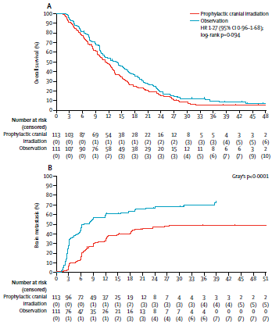
n= 224, primer sonlanım tüm SK
PKI öncesi ve izlemde MRG standart
Doz/fr standart 10x250cGy
G3-4 toksisite %4 vs %2.5 (ns)
QoL verisi Ø- MMSE ΔØ
GS
 | PKI | Kontrol
BM | %48 | %69
1y BM | %33 (%95 CI 24–42) | %59 (%95 CI 49–68)
1y GS | %48 (95% CI 38·9–57·3) | %54 (%95 CI 43·8–62·4)
GS | 11.6ay (95% CI 9·5–13·3) | 13.7ay (95% 10·2–16·4)
Beyin metastazı
Kurtarma RT %83
Sonuç: Tanı anı MRG’de metastazı Ø kanıtlanan olgularda PKI, MRG ile yakın izlem ve asemptomatik beyin metlerin erken tanınmasıyla yapılan kurtarma RT koluna göre SK fark Ø
Notes:
Tanı anı MRG’de metastazı olmadığı kanıtlanan olgularda PKI, MRG ile yakın izlem ve asemptomatik beyin metlerin erken tanınmasıyla yapılan salvaj RT koluna göre sağkalımı arttırmamıştır
330 PLANLANMIŞ AMA İNTERİM ANALİZDE FAYDASIZLIK ÖRÜLÜNCE SONLANDIRILMI-NOSAKİIn the study conducted by Takahashi et al[122] all patients underwent MRI prior to PCI. The cumulative incidence of BM in the two arms (PCI vs observation) was 48% and 69%, respectively.Despite the lower rate of BM with PCI, this did not improve OS (Table 6).The PCI dose in ES-SCLC is 2500 cGy in 10 fractions (level of evidence I, grade of recommendation A) and 2000 cGy in 5 fractions[38]; however, the neurocognitive effects of the latter scheme have not been fully investigated-CAUNAGO
Conversely, among patients in the surveillance arm of the EORTC trial who developed symptomatic brain metastases, only 59% received salvage radiation. Thus, 41% with symptomatic brain metastases in the observation arm of the EORTC trial were unable to receive salvage radiation, raising the question of whether this difference could have contributed to the decreased OS without PCI.TAYLOR Other potential explanations for the differences in the effect of PCI may include biologic heterogeneity between the European and Japanese populations that has impacted randomized trial data before TAYLOR
PCI deteriorates survival compared with a periodic follow-up with brain MRI, and the negative impact on quality-of-life due to prolonged anorexia and nausea after PCI was considered to be a primary reason OUTCHI
Although two MTA and one pooled analysis have shown that PCI improves OS in patients with ES-SCLC[157-149], the result of another MTA called into question the value of PCI[150]. Consequently, the decision to use PCI or not should be discussed with the radiation oncologist. Patients with ES-SCLC who progress after PCh should not receive PCI-Caunago
In ES-SCLC, the use of PCI was examined in a randomized trial of patients with any response to upfront chemotherapy.10 Patients had no known BMs, but brain imaging was not mandated as part of the standard staging or follow-up procedures. PCI reduced symptomatic BMs and resulted in improved OS. Similarly, meta-analyses8,81,94,95 and some pooled analyses82,83 demonstrated OS to be favorably associated with PCI usage in ESSCLC.
However, a different meta-analysis questioned the OS benefit of PCI in ES-SCLC.96 A more contemporary Japanese randomized study was designed to
examine MRI surveillance compared with PCI.13 PCI resulted in a significantly decreased burden of BMs compared with MRI surveillance (48% vs 69%). However, OS was not improved.13 It should be noted that no quality of life and limited neurocognition data are available from this trial. Therefore, for patients who can adhere to the schedule, MRI surveillance can be considered an alternative to PCI. The task force recommends consultation with a radiation oncologist regarding the benefits and risks of PCI versus MRI surveillance. Similar to patients with LS-SCLC, patients with ES-SCLC who progress
after initial therapy should not be recommended for PCI. Among patients with ES-SCLC who elect to have PCI, the task force agreed that data supporting utilization of 2500 cGy in 10 fractions are likely applicable regarding disease control and neurotoxicity.92,93 This regimen has
been extensively used in patients with ES-SCLC undergoing PCI.10,97,98 However, given that the strongest randomized data supporting PCI for ES-SCLC delivered 2000 cGy in 5 fractions of 400 cGy to 62% of the patients receiving PCI,10 that fractionation scheme also garnered support as an evidence-based regimen, although neurocognitive effects for this scheme have not been studied.-SIMONE ASTRO
Due to the contrasting results of 2 randomized trials evaluating PCI in stage IV disease [24,25], there is a need for a new
trial comparing PCI (with or without hippocampal sparing) to MRI surveillance in the combination chemo-immunotherapy eraLE PECHOUX-ESTRO

Slide 16
EORTC
JAPON
Kurtarma RT % 59
Kurtarma RT % 83
Notes:
GS japonda daha iyi The median overall survival for all patients was longer in the Japanese study than in the EORTC trial. The participating Japanese centres, however, included 1 patient per year on average, raising the question whether the results can be generalized to all patients. The majority of patients in the Japanese study developed brain metastases for which radiotherapy was initiated; 46% in the PCI group and 83% in the observation groupPUTORA
Manapov et al., 40 patients with LS-SCLC who achieved CR to concurrent chemoradiotherapy and were indicated for PCI were subjected to contrast-enhanced head MRI before receiving PCI, and the findings revealed asymptomatic brain metastases in 13 cases (32.5%) [13].
In the EORTC study, MRI was not carried out before PCI, therefore it could not be ruled out that patients with asymptomatic brain metastasis
may have been included among the participants, and that the tudy results may have been influenced by the treatment effect
Thus, we believe that PCI is not essential when periodic MRI examinations are available. Researchers have compared the two trials and indicated that the EORTC study did not rule out patients with asymptomatic BM because MRI was not performed before PCI. Thus, the effect of PCI on these patients may have influenced the results. TIAN
Referring to the EORTC and Japanese trials, both PCI and periodic MRI examinations are applicable to ES-SCLC. The majority of radiation and medical oncologists worldwide recommend brain MRI before PCI and advise PCI for patients with ES-SCLC after systemic CHT, primarily confined to the fit and non-elderly patient population in consideration of toxicities [64–66]. TIAN

Slide 17
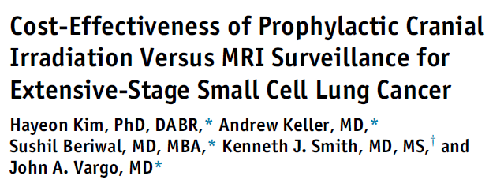
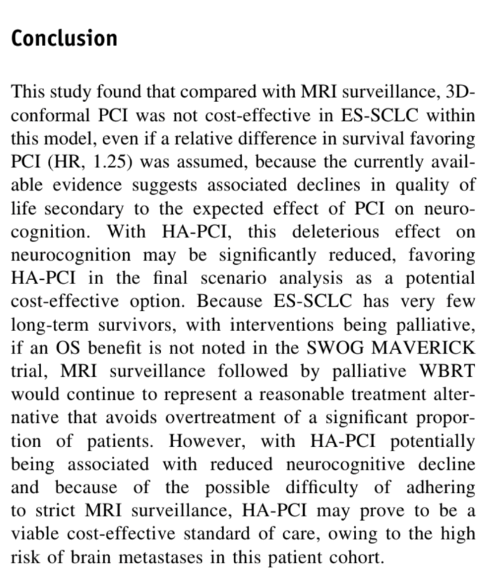
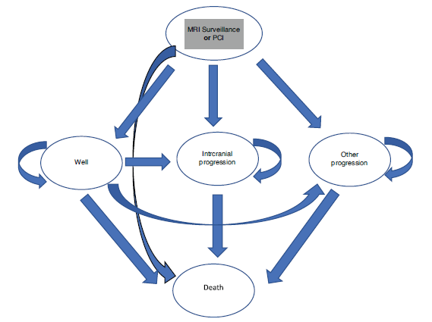

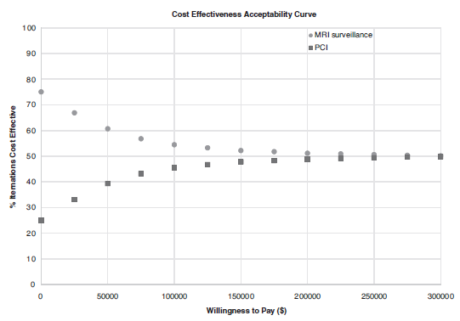
YE-PKI maliyet/etkinlik?
Notes:
NOSAKI

Slide 18
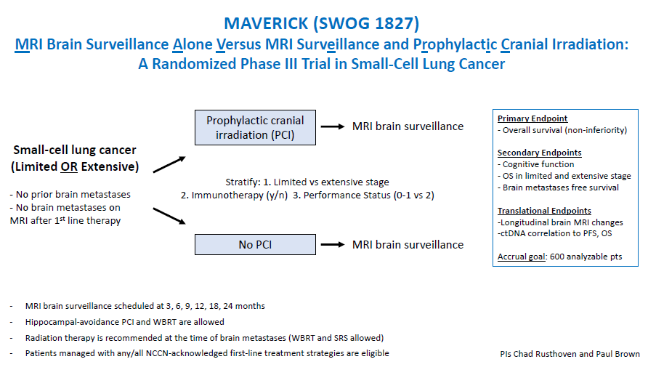
Sınırlı ve Yaygın Evre KHAK’de PKI
Notes:
Non-inferiority trialNotably, an ongoing randomized phase 3 trial (MAVERICK) is recruiting an estimated 668 patients with SCLC to test whether the use of MRI alone, instead of MRI plus PCI, affects OS (NCT04155034). Retrospective studies and meta-analyses indicated that PCI was associated with a significantly longer survival and delayed appearance of BM compared to non-PCI TIAN
Related trials in the space of SCLC brain management include the SWOG S1827 Maverick trial (ClinicalTrials.gov identifier: NCT04155034), a phase III trial that compares HA-PCI or standard PCI (radiotherapy technique chosen per patient and clinician discretion) followed by magnetic resonance imaging (MRI) surveillance versus MRI surveillance alone.BROWN
Non- inferiorıty trial
The results of ongoing SWOG 1827 (NCT04155034), a randomized phase III trial comparing PCI with MRI surveillance and MRI surveillance alone in patients with SCLC, might redefine the role of PCI for patients with LS-SCLC in the MRI era and increase the importance of avoiding neurocognitive deterioration. In that sense, the development of new radiation techniques, including HA-PCI, should be continued. OUTCHI
SWOG 1827, “MRI brain surveillance alone versus MRI surveillance and prophylactic cranial irradiation: a randomized phase III trial in small-cell lung cancer (MAVERICK)” which was activated in early 2020 with a planned enrollment of 600 patients with either LS-SCLC or ES-SCLC. The primary endpoint of the MAVERICK study tests the hypothesis that a strategy of MRI surveillance alone, allowing for early salvage radiation therapy in patients who develop brain metastases, can offer non-inferior OS when compared to MRI surveillance plus PCI. Key secondary endpoints will assess whether MRI surveillance alone is associated with improved cognitive preservation and quality of life, as well as the effect of PCI on OS in the subgroups with LS-SCLC or ES-SCLC. Pre-randomization strata includes: (I) LS vs. ES disease, (II) planned ICI or not, and (III) performance status 0–1 vs. T
MAVERICK is a pragmatic trial designed to minimize barriers to accrual allowing varying and evolving SCLC practice patterns including immunotherapy, consolidative thoracic radiation for ES-SCLC, HA-PCI, memantine, and salvage therapies including WBRT, HA-WBRT, and SRS at the discretion of the treating physician. This trial is supported by a recent patterns of care survey amongst 487 radiation oncologists which reported that routine recommendation for PCI in ES-SCLC had dropped from 72% to 44% following the Japanese trial, and that 82% of respondents would be willing to enroll patients with either LS and/or ES SCLC on a trial comparing MRI surveillance with and without PCI (42-44). An important design feature of the MAVERICK trial is the pre-randomization stratification by LS-SCLC and ES-SCLC which will ensure balance between the arms while allowing investigators to enroll the patients with the stage of SCLC for which they have equipoise on the PCI question (i.e., LS-SCLC, ES-SCLC, or both). The results from this trial will ultimately address many of the controversial questions that have generated equipoise regarding the role of PCI in ES-SCLC, and hopefully help define the role of PCI for LS-SCLC and ES-SCLC in the modern era of ICI and opportunity to manage with MRI surveillance and early SALVAGE RX TAYLOR
The benefit of PCI is unclear in patients who have undergone definitive therapy for very early LS-SCLC, ie, pathologic stage I–IIA (T1–2,N0,M0).9 These
patients have a lower risk of developing brain metastases than patients with more advanced, LS-SCLC and may not benefit from PCI.9 Brain MRI
surveillance should be performed in patients not receiving PCI.9 However, PCI may have a benefit in patients who are found to have pathologic stage
IIB or III SCLC after complete resection.9,37 This issue is being evaluated in the ongoing NCI cooperative group trial SWOG S1827/MAVERICK (brain MRI
surveillance ± PCI), which includes the population undergoing surgical resection.-nccn

Slide 19
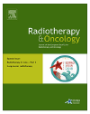
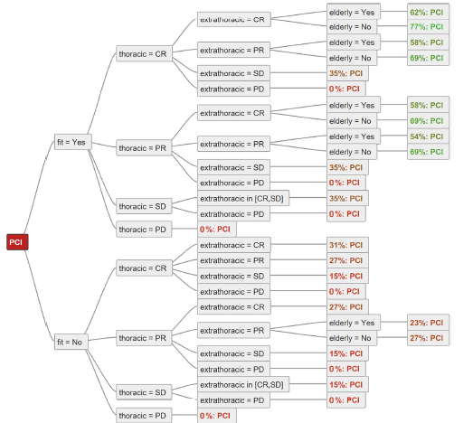
ESTRO-IASLC
Putora et al. Radiotherapy and Oncology 2019;133:163-6
Notes:
experts from both ESTRO and IASLC, representing European radiation and medical oncologists specializing in lung
cancer, recommend PCI in selected patients and restrict its use primarily to fit, non-elderly patients who responded to chemotherapy
(CR/PR). Overall, the criteria used by the experts are stricter than the inclusion criteria of the EORTC study. The restricted availability
of brain MRI and possible doubt regarding the translation of the Japanese results (different ethnicities and inclusion criteria) may
explain why at the time of the analysis, brain MRI surveillance was not suggested by the majority of experts.
RESULTS: The factors associated with the recommendation for the use of PCI included the fitness of the
patient, young age and good response to chemotherapy. PCI was recommended by the majority of experts
for non-elderly fit patients who had at least a partial response (PR) to chemotherapy (for complete remission
(CR) 85% of radiation oncologists and 69% of medical oncologists, for PR: 85% of radiation oncologists
and 54% of medical oncologists). For patients with stable disease after chemotherapy, PCI was recommended
by 6 out of 13 (46%) radiation oncologists and only 3 out of 13 medical oncologists (23%).

Slide 20
KT’ye yanıtlı olgularda PKI kararına rehberlik için kontrastlı MR ile yeniden evreleme önerilir
Kanıt düzeyi | Öneri düzeyi
Düşük | Güçlü
Simone ve ark. Int J Radiat Oncol Biol Physcs 2020
Daly ve ark JCO 2021
Notes:
NC etkileri tanımlanmamış olmasına rağmen SLOTMN’ın YE’de yaklaşımım belirleyen çalışmasında %60 bu şemayı aldığı için önerilmek zorunda
What are the indications, appropriate dose-fractionation schedules, and timing of
prophylactic cranial RT for LS-SCLC and ES-SCLC?
For patients with SCLC who respond to initial therapy, restaging with brain MRI to guide decision making regarding PCI is recommended.
For patients with ES-SCLC who respond to chemotherapy, consultation with a radiation oncologist to enhance shared decision making on PCI versus MRI surveillance (considering patient- and disease-specific characteristics) is recommended
For patients with ES-SCLC who elect PCI, 2,500 cGy in 10 fractions or 2,000 cGy in 5 fractions is recommended
Given the importance of central nervous system as a site of failure in SCLC, and in the context of PCI consideration, magnetic resonance imaging (MRI) restaging after completion of chemoradiation is recommended. Studies examining the value of restaging MRI after upfront chemoradiation
indicate interval development of BMs in 20% to 32% of patients.73,74 This information imparts prognostic
information and guides decision making on whole-brain RT intent and dosing. MRI with contrast is the recommended
imaging modality given higher sensitivity for small lesions; however, contrast-enhanced CT maintains a role in
staging and surveillance for patients with pacemakers or other MRI contraindications.SIMONE

Slide 21
ASTRO-ASCO
Kanıt düzeyi | Öneri düzeyi
Orta | Güçlü
KT’ye yanıtlı olgularda PKI / MR izlem için RO konsültasyon önerilir
Simone ve ark. Int J Radiat Oncol Biol Physcs 2020
Daly ve ark JCO 2021
Notes:
Progrese olanlar dışında
the task force agreed that data supporting utilization of 2500 cGy in 10 fractions are likely applicable regarding
disease control and neurotoxicity.92,93 This regimen has been extensively used in patients with ES-SCLC undergoing
PCI.10,97,98 However, given that the strongest randomized data supporting PCI for ES-SCLC delivered 2000 cGy in 5 fractions of 400 cGy to 62% of the patients receiving PCI,10 that fractionation scheme also garnered support as an evidence-based regimen, although neurocognitive
effects for this scheme have not been studied.ASTRO
NC etkileri tanımlanmamış olmasına rağmen SLOTMN’ın YE’de yaklaşımım belirleyen çalışmasında %60 bu şemayı aldığı için önerilmek zorunda
What are the indications, appropriate dose-fractionation schedules, and timing of
prophylactic cranial RT for LS-SCLC and ES-SCLC?
For patients with SCLC who respond to initial therapy, restaging with brain MRI to guide decision making regarding PCI is recommended.
For patients with ES-SCLC who respond to chemotherapy, consultation with a radiation oncologist to enhance shared decision making on PCI versus MRI surveillance (considering patient- and disease-specific characteristics) is recommended
For patients with ES-SCLC who elect PCI, 2,500 cGy in 10 fractions or 2,000 cGy in 5 fractions is recommended
the impact of PCI on neurocognitive function may be ameliorated by use of memantine [N-methyl-D-aspartate (NMDA) receptor antagonist] in combination with hippocampal-avoiding whole brain RT (HA-WBRT) techniques. This was recently demonstrated in a large randomized trial (NRG Oncology CC001), showing an 11% absolute reduction in neurocognitive dysfunction via incorporation of HA-WBRT with memantine in patients with brain metastases (SCLC patients were excluded) -NESBIT

Slide 22
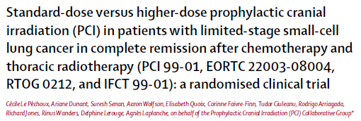
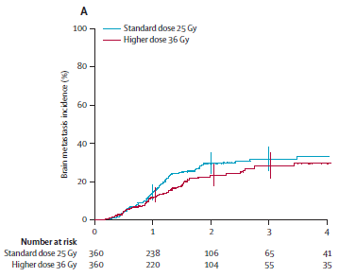
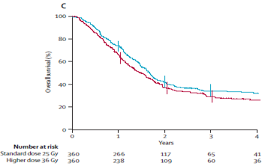
PKI doz
Tam yanıtlı -LS SCLC 720 olgu
Standart doz (25 Gy/10 frk) vs
yüksek doz (36 Gy/2 Gy, 18 fx veya 36 Gy/1,5 Gy günde 2 kez, 24fr
BM insidansında Δ Ø
Yüksek dozda mortalitede ve yan etkilerde (halsizlik, bulantı, baş ağrısı) ↑ (+)
25 Gy standart kalmalı
2 y GS 42% (95% CI 37–48) vs 37% (32–42)
HR: 1·20 [95% CI 1·00–1·44] p=·05
2 y BM %29 vs %23
HR: 0·80 (0·57–1·11) p=·18)
Notes:
25 Gy/10 fx is standard. This was investigated in the EORTC/RTOG 0212 prospective randomized trial39 composed
of three treatment arms: 25 Gy/10 fx, 36 Gy/18 fx QD, and 36 Gy/24 fx BID. Incidence of brain mets at
2 years was approximately 25% in all arms with no statistical difference; rates of chronic neurotoxicity were
greater in the 36 Gy cohort (p = .02
The Auperin meta-analysis, through an indirect comparison of the trials, suggested an eff ect of PCI dose on brain metastases. The reduction in brain metastases with PCI was 24%, 48%, 68%, and 73% with a total dose of 8 Gy, 24–25 Gy, 30 Gy, and 36–40 Gy, respectively. We therefore designed a trial to compare a standard dose of 25 Gy with a higher dose of 36 Gy, to assess the eff ect of PCI dose escalation on the incidence of brain metastase
metastases at 2 years. Secondary endpoints were overall and disease-free survival at 2 years, and long-term yearly assessment of neurological functions and quality of lifE
Mortalitede yüksek doz ,le olan artışı PCI dozuna bağlamıyorlar.

Slide 23
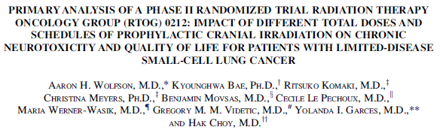
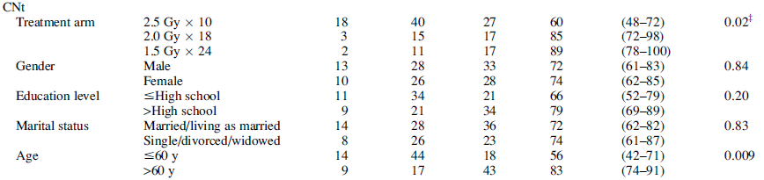
PKI doz
n= 265
QoL-C30/BN20
NKF testler
HVLT
COWAT
TMT-A/B
Artan doz ve yaş; 12. ayda kronik nörotoksisite için en güçlü prediktif faktör
Notes:
Artan doz ve yaş 12. aydaki kr. Nörotoksisite için en güçlü prediktif faktörler.
60 y üstü %83 geliştirirken altı %56
DSDSEW60 y üstü %83, 60 y altı %59 PCI sonrası 6. ayda kronik nörotoksisite, Eşzamanlu-ı KT ve>30 Gy kaçınılmalı
DAMHUIS- older age independent predictor of neurotoxicity at 12 months.
RTOG 0212 was designed with two specific goals. First, the study was to contribute patients to the
international PCI phase III trial that evaluated the impact of total dose of PCI on the incidence of brain metastasis at two years, overall survival, and disease-free survival. The accrual to the international study was achieved in December 2005 of which 146 patients were enrolled from RTOG 0212 [4]. Second, since there was a two-part randomization scheme not only between 25 Gy versus 36 Gy total PCI dose but also between daily and
twice daily fractionation with the 36 Gy total PCI dose arms, RTOG 0212 was planned as a phase II trial to determine the impact of PCI total dose and treatment schedule on incidence of chronic neurotoxicity (CNt) and on quality of life (QoL). This study required a total of
264 evaluable patients, including the first 146 patients co-enrolled into the internationalstudy, in order to perform its objectives. Thus, this report is an analysis of the initial results of RTOG 0212.WOLFSON

Slide 24
ASTRO-ASCO
Soru: YE-KHAK’nde PKI endikasyon, uygun doz-fraksiyonasyon ve zamanlaması nasıldır?
Kanıt düzeyi | Öneri düzeyi
Orta | Güçlü
PKI dozu 10x250 cGy veya 5x400 cGy önerilir
Simone ve ark. Int J Radiat Oncol Biol Physcs 2020
Daly ve ark JCO 2021
Notes:
5x 400’ün NKF outcome’ını bilmiyoruz.
the task force agreed that data supporting utilization of 2500 cGy in 10 fractions are likely applicable regarding
disease control and neurotoxicity.92,93 This regimen has been extensively used in patients with ES-SCLC undergoing
PCI.10,97,98 However, given that the strongest randomized data supporting PCI for ES-SCLC delivered 2000 cGy in 5 fractions of 400 cGy to 62% of the patients receiving PCI,10 that fractionation scheme also garnered support as an evidence-based regimen, although neurocognitive
effects for this scheme have not been studied.ASTRO
NC etkileri tanımlanmamış olmasına rağmen SLOTMN’ın YE’de yaklaşımım belirleyen çalışmasında %60 bu şemayı aldığı için önerilmek zorunda
What are the indications, appropriate dose-fractionation schedules, and timing of
prophylactic cranial RT for LS-SCLC and ES-SCLC?
For patients with SCLC who respond to initial therapy, restaging with brain MRI to guide decision making regarding PCI is recommended.
For patients with ES-SCLC who respond to chemotherapy, consultation with a radiation oncologist to enhance shared decision making on PCI versus MRI surveillance (considering patient- and disease-specific characteristics) is recommended
For patients with ES-SCLC who elect PCI, 2,500 cGy in 10 fractions or 2,000 cGy in 5 fractions is recommended

Slide 25
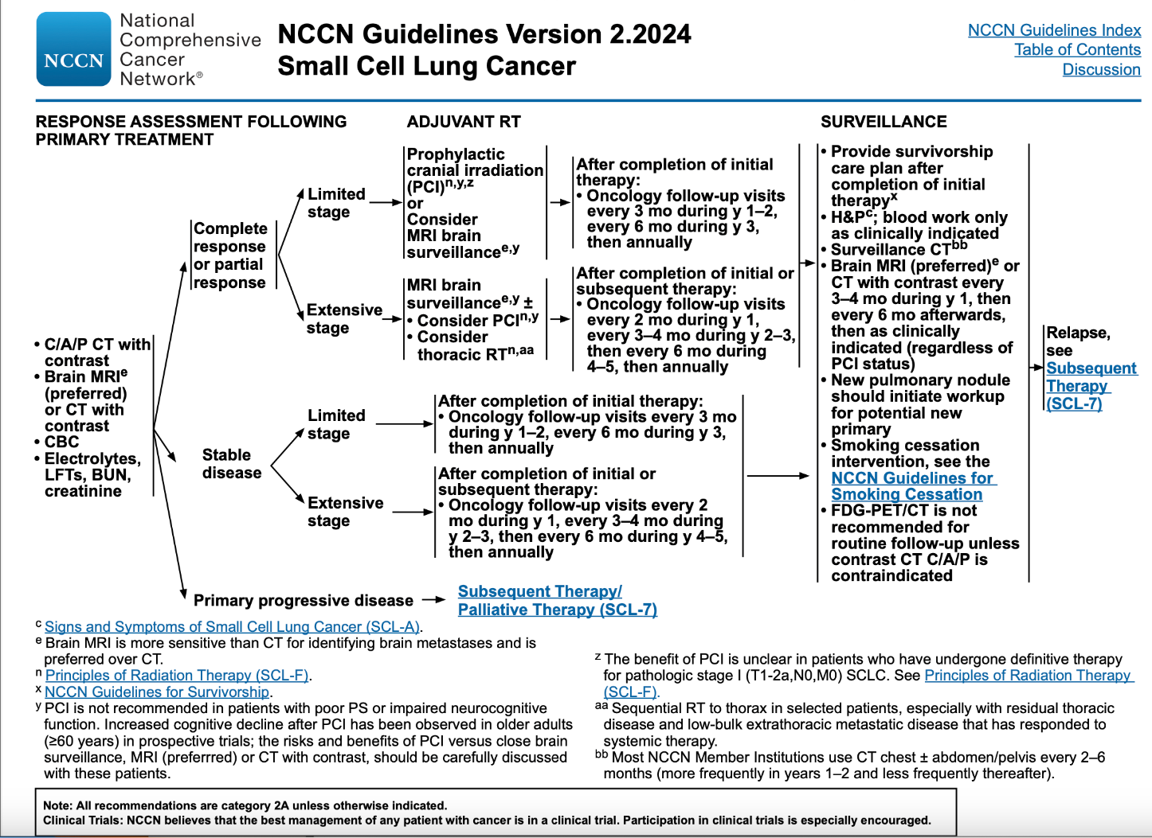

Slide 26
Nörotoksisite
KT ile eşzamanlı
>3 Gy/fr
ECOG ¾
NKF↓
+/- Memantine (RTOG 0614)
>60y kronik nörotoksisite ile ilişkili
PKI-Hipokampal koruma
PKI Ø
NCCN Guidelines v1. 2023 Small Cell Lung Cancer
Le Pechoux Ann Oncol 2011;22:1154-1163
Slotman Int J Rad Oncol Biol Phys 2011;79:998-1003
Wolfson et al. Int J Rad Oncol Biol Phys 2011;81:77-84
Notes:
NCCN2019 dan itibaren RTOG 0614 (brown-2013)triala göre memantin dozAJINI algoritmaya eklemiş.NCF’da düşüşü geciktiriyor
Sistemik tedavinin akut etkileri geçtikten sonra yapılmalı

Slide 27
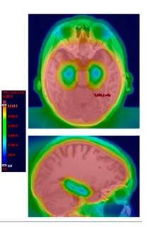
PKI Nörotoksik etkisini HipoKampal Koruma ile azaltabilir miyiz?
Notes:
The risk of chronic neurocognitive impairment caused by RT-induced damage to the hippocampus is worth noting in consideration of PCI [81]. Hippocampal-avoidance PCI (HA-PCI) can delay or reduce the severity of neurocognitive decline [82]. RTOG 0933 suggested that HA-WBRT is associated with memory preservation [83]. A single-arm prospective study indicated that the cumulative rate of asymptomatic BM after HA-PCI was 20% [84]. A randomized phase 3 PREMER trial suggested that compared with standard PCI, HA-PCI could better preserve cognitive function [85]. Nevertheless, brain failure, OS, and quality of life (QoL) were not significantly different between groups. However, a multicenter, randomized phase 3 trial from the Netherlands (NCT01780675) did not reveal a lower probability of cognitive decline in patients with SCLC receiving HA-PCI than in those receiving standard PCI [86]. The incidence of BM at 2 years did not increase with HA-PCI. NRG Oncology CC003 is an ongoing randomized phase 2/3 trial aimed at evaluating the effect of HA-PCI on the intracranial relapse rate and cognitive function in SCLC [87]. tıan

Slide 28
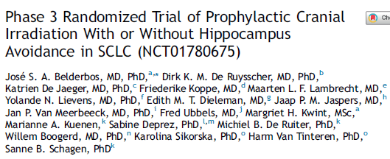
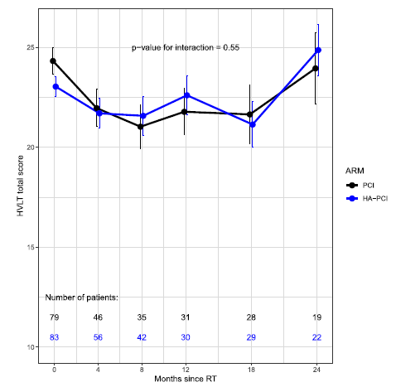
2021
n= 168 med izlem= 26.6 ay (yaşayan)
Yaygın evre: %30
Primer sonlanım: 4 ay öğrenme-HVLT-R
Primer sonlanım
4.ay total hafıza (HVLT-R)
Sekonder sonlanım
HVLT-R (diğer parametreler)
TMT-A ve B
COWAT
BM insidansı
GS
Total hafıza HVLT-R (>5 puan)
%29 vs %28 p= 0.99
HP/HA zone met
izole HP met Ø
multiple met(+)
4/11 olgu HP met (+)
1/11 olgu HA zone met (+)
Notes:
Hollanda
168 patients with SCLC who completed chemo (radio) therapy were randomized to receive standard PCI or HA-PCI of 25 Gy in 10 fractions. HA-PCI did not increase the risk of brain metastases including hippocampus and did not show negative impact on survival compared with standard PCI; however, HA-PCI failed to prevent the decline of neurocognitive function compared with standard PCI. As a result, this was a negative study. Nevertheless, the study provided us an opportunity to re-think about PCI for SCLC. OUTCHI
NKI trial: 168 pts randomized to PCI vs PCI-HA 25 Gy/ 10 tx Primary endpt: HVLT total recall decline of >/=5 points at 4 mos 4 Month HVLT total recall decline : 29% PCI vs 28% HA-PCI p=0. 99 8 Month HVLT total recall decline: 34% PCI vs 26 HA-PCI p = 0. 46 Average HVLT total recall decline: 4 mos— 2 pts PCI, 2 pts HA-PCI 8 mos— 3 pts PCI, 1 pt HA-PCI No difference in intracranial relapse rates

Slide 29
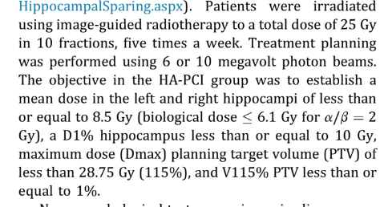
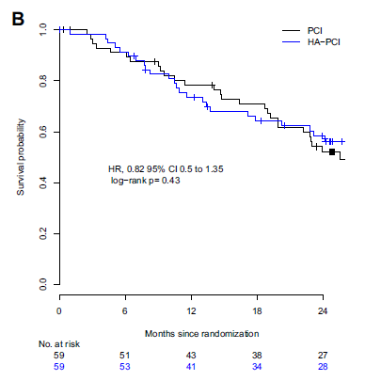
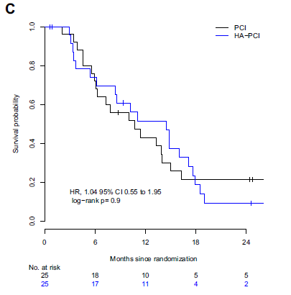
2021
HA dozu mean median vs max?
Konturlama? QA yok
6Gy biyolojik ilaç desteği olmadan yeterli koruma sağlamıyor?
HP/HA zone met
izole HP met Ø
multiple met(+)
4/11 olgu HP met (+)
1/11 olgu HA zone met (+)
Evre IV
Evre I-III
HK-PKI güvenilir ancak klinik çalışma dışında önerilmemelidir

Slide 30
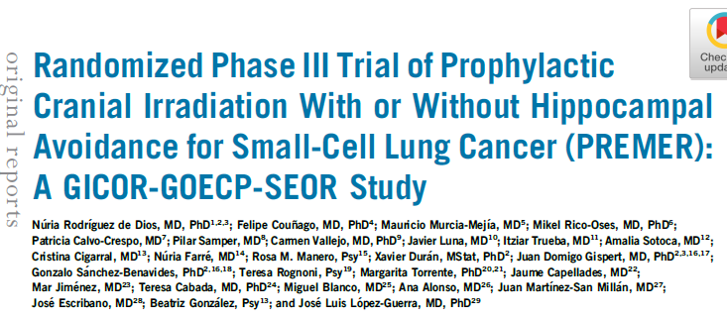
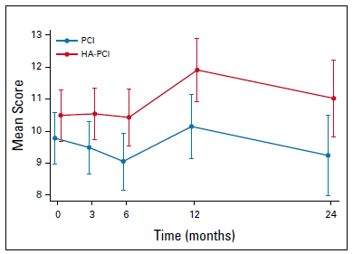
3. Ay FCSRT ↓ skoru
n= 150
med. izlem= 21 ay (Yaşayan= 40.4 ay)
YE-KHAK %28.9
Primer sonlanım
3.ay gecikmiş serbest hafıza(FCSRT)
Sekonder sonlanım
BM insidansı
GS
QoL (QLQ C30-BN20)
3. ay ↓ PCI vs. HA-PCI %23.5 vs. %5.8
Notes:
The PREMER RCT from Spain randomized patients receiving PCI for SCLC to PCI vs. HA-PCI and hasbeen preliminarily reported in abstract form only, showing a decline in free delayed recall in PCI vs. HA-PCI(33% vs. 7% at 6 months, p = .008).42 NRG CC003 is an RCT investigating PCI vs. HA-PCI in LS-SCLC and ES-SCLC; outcomes include intracranial relapse rates and differences in delayed recall.43 Results are awaited.
PCI vs PCI-HA 25 Gy/ 10 tx
Primary endpt: Free & Cued Selective Reminding Test(Encoding and retrieval-Kodlama ve geri çağırma) 3 Month decline in delayed free recall: 27% PCI vs 3% HA-PCI p=0. 01 6 Month decline in delayed free recall: 48. 1% PCI vs 4. 8% HA-PCI p = 0. 001 6 Month decline in total free recall: 33. 3 % PCI vs 4. 8% HA-PCI p = 0. 01 N. Rodriguez de Dios et. al. The FCSRT is a validated,well-established measure that has many similarities and some differences with the Hopkins Verbal Learning Test-Revised (HVLT-R), a cognitive test frequently used in oncology clinical trials. Most importantly, the FCSRT teaches the person learning the list to use categories in the word list to enhance initial learning of information. The categories are also useful in cueing subjects after a delay period to enhance retrieval. Thus, the test separates the elements of encoding and retrieval, which tend to be related to frontal or subcortical networks, from the process of consolidation in recent memory, which is critically dependent upon hippocampal neurogenesis function. 14 The GOECP-SEOR trial found significantly less decline on delayed free recall on the FCSRT at 3 months associated with HA-PCI (5.8%) compared with PCI (23.5%). Additional analyses found less decline in learning at 3, 6, and 24 months and delayed free recall at 6 months after HA-PCI. Overall survival, incidence of brain metastases, and QOL C-30BN-20patient-reported outcomes were not significantly different between study arms.BROWN
RESULTS: Each recall score separately reported a significant difference in NCF at 3, 6, and 24 months. QoL aynıDE DIOS

Slide 31
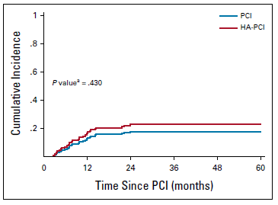
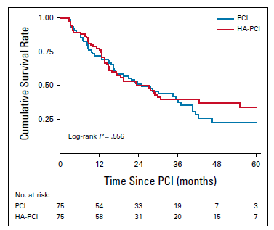
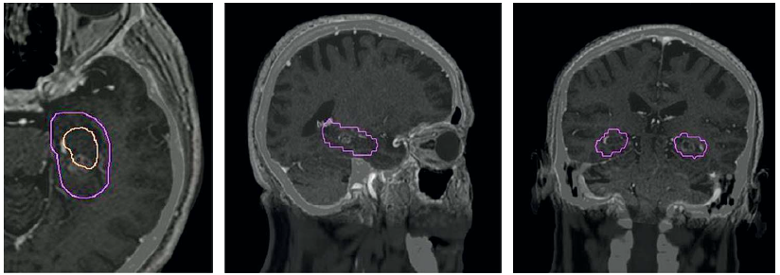
HP/HA zone met
izole HP met
1 olgu
multiple met(+)
2/12 olgu HA zone met (+)
HK-PKI NKF ları korur, BM, GS ve QoL’ni negatif yönde etkilemez
Notes:
The PREMER RCT from Spain randomized patients receiving PCI for SCLC to PCI vs. HA-PCI and has
been preliminarily reported in abstract form only, showing a decline in free delayed recall in PCI vs. HA-PCI
(33% vs. 7% at 6 months, p = .008).42 NRG CC003 is an RCT investigating PCI vs. HA-PCI in LS-SCLC and
ES-SCLC; outcomes include intracranial relapse rates and differences in delayed recall.43 Results are awaited.
PCI vs PCI-HA 25 Gy/ 10 tx
Primary endpt: Free & Cued Selective Reminding Test(Encoding and retrieval-Kodlama ve geri çağırma) 3 Month decline in delayed free recall: 27% PCI vs 3% HA-PCI p=0. 01 6 Month decline in delayed free recall: 48. 1% PCI vs 4. 8% HA-PCI p = 0. 001 6 Month decline in total free recall: 33. 3 % PCI vs 4. 8% HA-PCI p = 0. 01 N. Rodriguez de Dios et. al. The FCSRT is a validated,well-established measure that has many similarities and some differences with the Hopkins Verbal Learning Test-Revised (HVLT-R), a cognitive test frequently used in oncology clinical trials. Most importantly, the FCSRT teaches the person learning the list to use categories in the word list to enhance initial learning of information. The categories are also useful in cueing subjects after a delay period to enhance retrieval. Thus, the test separates the elements of encoding and retrieval, which tend to be related to frontal or subcortical networks, from the process of consolidation in recent memory, which is critically dependent upon hippocampal neurogenesis function. 14 The GOECP-SEOR trial found significantly less decline on delayed free recall on the FCSRT at 3 months associated with HA-PCI (5.8%) compared with PCI (23.5%). Additional analyses found less decline in learning at 3, 6, and 24 months and delayed free recall at 6 months after HA-PCI. Overall survival, incidence of brain metastases, and QOL C-30BN-20patient-reported outcomes were not significantly different between study arms.BROWN
RESULTS: Each recall score separately reported a significant difference in NCF at 3, 6, and 24 months. QoL aynıDE DIOS

Slide 32
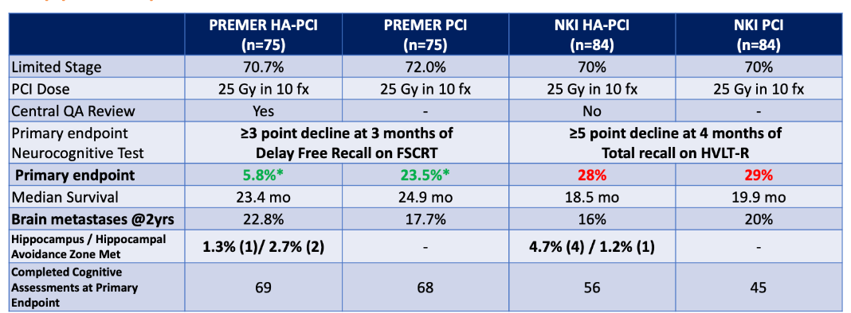
 | NKF Test farklılığı | Merkezi HP konturlama QA | NKF test tamamlayan n
 |  |  | PKI (168) | HA-PKI(150)
NKI | dikkatin öğrenme üzerine etkilerine daha hassas | (-) | 46 | 56
GOECP-SEOR | HP için (yeni bilgi kodlama-çağırma) daha spesifik | (+) | 68 | 69
HVLT-R: Hopkins Verbal Learning Test-Revised
FCSRT: Free and Cued Selective Reminding Test
Farklı sonlanım noktaları- özellikle de PREMER çalışmasında daha HK spesifik

Slide 33
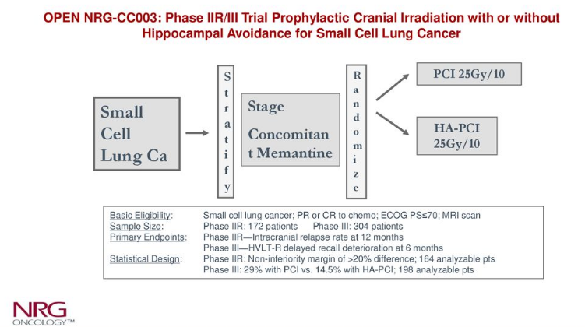
Notes:
Nisan 2022 de ilk sonuçlar-hasta alımı temmuz 2022 de tamamlanmış,
The NRG CC003 is a phase II/III randomized trial of PCI in SCLC with and without hippocampal avoidance that is currently ongoing. The phase II portion of NRG CC003 was designed to determine whether the 12-month intracranial relapse with HA-PCI was non-inferior to standard PCI, and the ongoing phase III component is designed to determine whether HA-PCI can reduce the likelihood of 6-month cognitive deterioration on the Hopkins Verbal Learning Test-Revised (HVLT-R). Of note, prior smaller randomized trials of PCI vs. HA-PCI have returned conflicting results regarding the cognitive impact of HA-PCI TAYLOR
a much larger trial of nearly 392 patients with SCLC and inclusive of central quality assurance of HA-PCI treatment plans randomly assigns patients between HA-PCI and PCI and stratifies by memantine use. With approximately 90% of target accrual already reached on NRG CC003, outcomes from this trial are expected to be reported in the next few years and are eagerly awaited.BROWN

Slide 34

Primary Endpoint Results of NRG CC003: Phase IIR/III Trial of Prophylactic Cranial Irradiation (PCI) with or without Hippocampal Avoidance (HA) for Small Cell Lung Cancer (SCLC)A) for Small Cell Lung Cancer (SCLC) Primary Endpoint Results of NRG CC003: Phase IIR/III Trial of Prophylactic Cranial Irradiation (PCI) with or without Hippocampal Avoidance (HA) for Small Cell Lung Cancer (SCLC)A) for Small Cell Lung Cancer (SCLC)
% 70 LS
% 47 Memantine (+)
HA-PKI had non-inferior 12-mo ICR rate (PKI 14.8% vs. HA-PKI 14.2%, p<0.0001 to rule out inferiority)
6-mo HVLT-R DR deterioration was not significant (PCI 30.0% vs. HA-PCI 26.0%, p=0.31).
Addition of HA to PKI prevented NKF failure (adjusted HR=0.77, 95% confidence interval (CI): 0.61-0.98, p=0.03)
Memantine use trended to increased NKF failure (adjusted HR=1.26, 95% CI: 0.99-1.59, p=0.062); test for interaction between HA and memantine use was non-significant. PARADOX!
HA-PKI arm had higher COWA scores at baseline (mean: PCI 31.9 vs. HA-PCI 34.4, p=0.019) and exhibited greater deterioration in COWA over time (estimate -0.259, p=0.042).
There were no differences in overall survival (adjusted HR=0.83, 95% CI: 0.63-1.09, p=0.19).
Conclusion While the study did not meet its HVLT-DR failure primary endpoint, HA during PCI prevents NCF failure with non-inferior ICR risk and similar survival. The NCF benefit of HA was independent of non-significant higher NCF failure risk with memantine use. Worse verbal word fluency, assessed using COWA, following HA-PCI requires further investigation given baseline between-arm imbalance in COWA scores.
ASTRO 2023
Notes:
Purpose/Objective(s)
Prior randomized trials have demonstrated neurocognitive function (NCF) benefits of HA during whole-brain radiotherapy for non-SCLC brain metastases. NRG CC003 sought to evaluate whether HA confers similar neuroprotection and non-inferior intracranial relapse (ICR) risk following PCI for SCLC.
Materials/Methods
SCLC patients (pts) were stratified by age, stage and planned memantine use, and randomized to PCI or HA-PCI (25Gy in 10 fractions). Standardized NCF tests of Hopkins Verbal Learning Test-Revised (HVLT-R), Trail Making Tests (TMT), and Controlled Oral Word Association (COWA) were performed at baseline, 3, 6, 12, 18 and 24 months (mos). The primary endpoints were 12-mo ICR (phase II) and 6-mo HVLT-R Delayed Recall (DR) failure, defined as decline using the reliable change index (phase III). To detect a 14.5% reduction in 6-mo HVLT-DR failure, 196 analyzable pts were required for 80% power and one-sided α=0.05. Phase III sample size was increased to 392 pts for non-compliance and death. Secondary endpoints were first failure in any NCF test and failure in other NCF tests. NCF failure was analyzed using Fisher's exact test and mixed effects models. Cumulative incidence estimated time to NCF failure (death without NCF failure was competing risk); between-arm comparison tested using Cox proportional hazards model.
Results
From 12/2015-6/2022, 392 pts were randomized; study closed from 10/2017-7/2020 for phase IIR analysis. Median age was 64. 70% had limited stage; 47% used memantine. Median follow-up was 14.9 mos (all pts) and 24 mos (alive pts). Grade≥3 toxicity did not differ. HA-PCI had non-inferior 12-mo ICR rate (PCI 14.8% vs. HA-PCI 14.2%, p<0.0001 to rule out inferiority). 6-mo HVLT-R DR deterioration was not significant (PCI 30.0% vs. HA-PCI 26.0%, p=0.31). Addition of HA to PCI prevented NCF failure (adjusted HR=0.77, 95% confidence interval (CI): 0.61-0.98, p=0.03). Memantine use trended to increased NCF failure (adjusted HR=1.26, 95% CI: 0.99-1.59, p=0.062); test for interaction between HA and memantine use was non-significant. HA-PCI arm had higher COWA scores at baseline (mean: PCI 31.9 vs. HA-PCI 34.4, p=0.019) and exhibited greater deterioration in COWA over time (estimate -0.259, p=0.042). There were no differences in overall survival (adjusted HR=0.83, 95% CI: 0.63-1.09, p=0.19).
Conclusion
While the study did not meet its HVLT-DR failure primary endpoint, HA during PCI prevents NCF failure with non-inferior ICR risk and similar survival. The NCF benefit of HA was independent of non-significant higher NCF failure risk with memantine use. Worse verbal word fluency, assessed using COWA, following HA-PCI requires further investigation given baseline between-arm imbalance in COWA scores. Supported by grants UG1CA189867 (NCORP) and U24CA180803 (IROC) from the NCI.

Slide 35

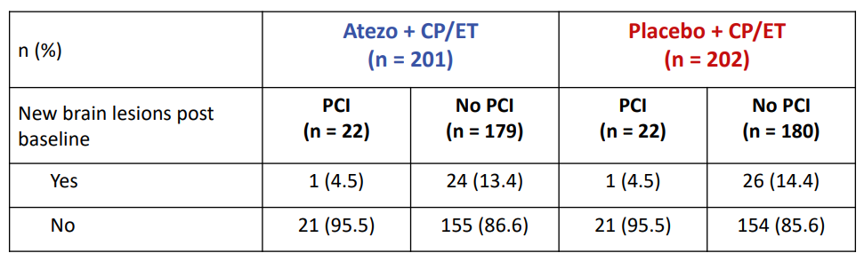
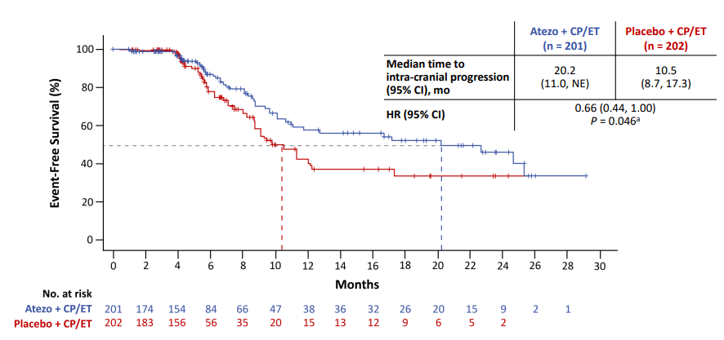
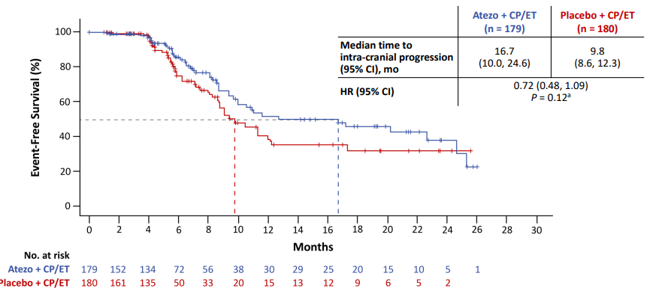
IT döneminde PKI – Impower-133
Intrakranyal progresyona kadar geçen süre
PKI Ø - Intrakranyal progresyona kadar geçen süre

Slide 36
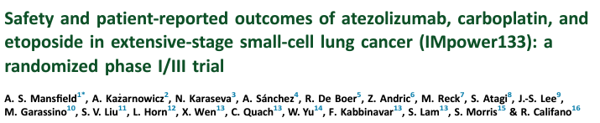
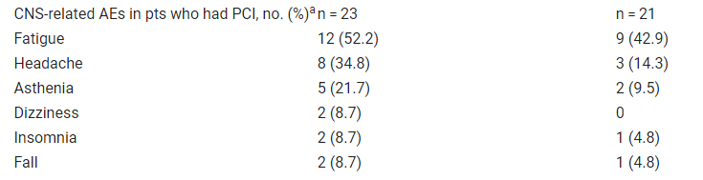
IT – IMpower133
EORTC QLQ-C30, QLQ-LC13
Mansfield Annals of Oncol 2020
Notes:
Importantly, in this study, consolidative thoracic RT was not allowed. The number of patients who received palliative thoracic RT was very low and no unexpected adverse events were observed. PCI was permitted, however only 22 patients in each group received PCI. In the patients who received PCI, CNS-related events appeared to be more common in the atezolizumab arm. However, number of events were low and causal relationship at this time is unclear (

Slide 37
IT döneminde PKI
Notes:
Non-inferiority trialNotably, an ongoing randomized phase 3 trial (MAVERICK) is recruiting an estimated 668 patients with SCLC to test whether the use of MRI alone, instead of MRI plus PCI, affects OS (NCT04155034). Retrospective studies and meta-analyses indicated that PCI was associated with a significantly longer survival and delayed appearance of BM compared to non-PCI TIAN
Related trials in the space of SCLC brain management include the SWOG S1827 Maverick trial (ClinicalTrials.gov identifier: NCT04155034), a phase III trial that compares HA-PCI or standard PCI (radiotherapy technique chosen per patient and clinician discretion) followed by magnetic resonance imaging (MRI) surveillance versus MRI surveillance alone.BROWN
Non- inferiorıty trial
The results of ongoing SWOG 1827 (NCT04155034), a randomized phase III trial comparing PCI with MRI surveillance and MRI surveillance alone in patients with SCLC, might redefine the role of PCI for patients with LS-SCLC in the MRI era and increase the importance of avoiding neurocognitive deterioration. In that sense, the development of new radiation techniques, including HA-PCI, should be continued. OUTCHI
SWOG 1827, “MRI brain surveillance alone versus MRI surveillance and prophylactic cranial irradiation: a randomized phase III trial in small-cell lung cancer (MAVERICK)” which was activated in early 2020 with a planned enrollment of 600 patients with either LS-SCLC or ES-SCLC. The primary endpoint of the MAVERICK study tests the hypothesis that a strategy of MRI surveillance alone, allowing for early salvage radiation therapy in patients who develop brain metastases, can offer non-inferior OS when compared to MRI surveillance plus PCI. Key secondary endpoints will assess whether MRI surveillance alone is associated with improved cognitive preservation and quality of life, as well as the effect of PCI on OS in the subgroups with LS-SCLC or ES-SCLC. Pre-randomization strata includes: (I) LS vs. ES disease, (II) planned ICI or not, and (III) performance status 0–1 vs. T
MAVERICK is a pragmatic trial designed to minimize barriers to accrual allowing varying and evolving SCLC practice patterns including immunotherapy, consolidative thoracic radiation for ES-SCLC, HA-PCI, memantine, and salvage therapies including WBRT, HA-WBRT, and SRS at the discretion of the treating physician. This trial is supported by a recent patterns of care survey amongst 487 radiation oncologists which reported that routine recommendation for PCI in ES-SCLC had dropped from 72% to 44% following the Japanese trial, and that 82% of respondents would be willing to enroll patients with either LS and/or ES SCLC on a trial comparing MRI surveillance with and without PCI (42-44). An important design feature of the MAVERICK trial is the pre-randomization stratification by LS-SCLC and ES-SCLC which will ensure balance between the arms while allowing investigators to enroll the patients with the stage of SCLC for which they have equipoise on the PCI question (i.e., LS-SCLC, ES-SCLC, or both). The results from this trial will ultimately address many of the controversial questions that have generated equipoise regarding the role of PCI in ES-SCLC, and hopefully help define the role of PCI for LS-SCLC and ES-SCLC in the modern era of ICI and opportunity to manage with MRI surveillance and early SALVAGE RX TAYLOR
The benefit of PCI is unclear in patients who have undergone definitive therapy for very early LS-SCLC, ie, pathologic stage I–IIA (T1–2,N0,M0).9 These
patients have a lower risk of developing brain metastases than patients with more advanced, LS-SCLC and may not benefit from PCI.9 Brain MRI
surveillance should be performed in patients not receiving PCI.9 However, PCI may have a benefit in patients who are found to have pathologic stage
IIB or III SCLC after complete resection.9,37 This issue is being evaluated in the ongoing NCI cooperative group trial SWOG S1827/MAVERICK (brain MRI
surveillance ± PCI), which includes the population undergoing surgical resection.-nccn

Slide 38

IT döneminde PKI
IT intrakranyal aktivite?
HK-PKI ±
Memantine NRG CC003
MRG izlem MAVERICK
PKI endikasyonu
Notes:
PKI kendisini HK planlama ve mementine ile kuvvetlendirmeye çalışıtkan, karşısında MRG ile yakın izlem ve IT’nin intrakranyal etkinliği ile çarpışmak zorunda kalacak gibi duruyor.
Increased utilization of immunotherapy for ES-SCLC may further erode the potential use of PCI in this population. The available data from the IMpower-133 study did not include incidence of new brain metastasis, so it is unknown if atezolizumab impacted the rate of intracranial progression in this population. However, extrapolating the evidence from the PACIFIC trial in NSCLC, the addition of immunotherapy reduced the incidence of brain metastases in NSCLC (6.3% vs. 11.8%) (34). There is also evidence of CNS activity with immunotherapy in a study of ipilimumab/nivolumab in melanoma metastatic to the brain (57). If the inclusion of immunotherapy does reduce the incidence (or pace) of brain metastases presentation in ES-SCLC, then the rationale for upfront, routine PCI usage would be further decreased. While HA-WBRT reductions in neurotoxicity (if confirmed in PCI setting per NRG CC003) may favorably change the therapeutic ratio of PCI, the potential alteration in the natural history of ES-SCLC with immunotherapy, in combination with the availability for surveillance MRI, may result in decreasing enthusiasm for PCI in ES-SCLC. Whether radiographically apparent brain metastases (at diagnosis or during active MRI surveillance) can be appropriately treated with stereotactic radiosurgery also remains an open question [as under examination in the ongoing ENCEPHALON trial -NESBIT

Slide 39
Gelecekten beklentiler
Genel:
Benefit of PCI in brain MRI era being re-evaluated in the MAVERICK Çalışması: MR era’da PCI faydasını araştırıyor
PKI yapılsın ya da yapılmasın her hastaya MR takibi öneriliyor
NRG CC003 ve PREMER çalışmaları ışığında HA-PKI önerilebilir. Memantine?
Sınırlı Evre KHAK
Yaşlı, nörokognitif problemleri olan hastalar dışında evre III hastada PKI halen Standart öneri
Yaygın Evre KHAK
• Özellikle IT döneminde PKI katkısı kısıtlı ve MR ile takip önerilebilir
Notes:
In today’s era of modern imaging, the extensive stage could vary from limited metastatic disease to disseminated metastatic disease, and VALSG classification limits our ability to stage these patients systematically. Systematic use of TNM is preferred, and its wider application should be supported. It would be preferred to incorporate this wisdom and refine treatment as per disease bulk-RATHOD
Although RT-immunotherapy can increase response rates, the development of persistent radiation-induced immunosuppression and toxicity can limit this function It is crucial to develop biomarkers specific to RT-immunotherapy to select the appropriate patient population and avoid unnecessary toxicity and cost. PD-L1, TMB, and TILs are biomarkers for immunotherapy in ES-SCLC [89]. Since the expression of PD-L1 in SCLC is usually lower, TMB needs to be tested and the combination of both can better predict immune efficacy [90]. The tumor microenvironment, including infiltrating T-cells, tumor-associated macrophages, and cancer-associated fibroblasts, is also important for evaluating the response to RT-immunotherapy [91]. Unlike NSCLC, SCLC has a more immunosuppressive tumor microenvironment (TME) [90]. Thus, more attention should be paid to the TME for better evaluation of immune status before commencement of RT-immunotherapy. - TIAN

Slide 40
Small Cell Lung Cancer
Not so small any more…
Teşekkür ederim…

